Slide 1
Ethical Decision Making
Module 3

Slide 2
Objectives
Implications of unethical issues in different functional areas of business like finance, HR and marketing
Economic ideologies: Capitalism, Socialism and Communism, Economics & Business ethics, Global Business practices, Consumerism, Human Rights, Healthcare and Labour, Sustainable Development;
Ethical Models, Tucker’s 5 Question model, American Accounting Association Model, Ethical Decision making process.

Slide 3
Implications of Unethical Issues in Different Functional Areas of Business
Unethical issues in business can have significant and far-reaching consequences across various functional areas. These issues can affect financial stability, employee morale, consumer trust, and a company's reputation. Here is an overview of how unethical practices in different functional areas such as finance, human resources (HR), and marketing can impact a business:

Slide 4
1. Finance
Ethical issues in finance, such as financial misreporting, insider trading, and fraudulent accounting, can lead to significant financial losses, legal consequences, and a damaged reputation. Some common unethical financial practices include:
Fraudulent Reporting: Manipulating financial statements to present a more favorable image of the company. This can deceive investors and stakeholders and may result in legal sanctions.
Insider Trading: Using confidential information to make profitable financial decisions, giving an unfair advantage to certain individuals.
Mismanagement of Funds: Misuse or diversion of company funds for personal gain can lead to bankruptcy or severe financial losses.

Slide 5
Implications:
Legal Consequences: Companies involved in unethical financial practices can face fines, lawsuits, or even shutdowns.
Loss of Trust: Investors, creditors, and consumers may lose trust in the company, making it difficult to secure financing or maintain customer loyalty.
Reputation Damage: The company’s brand and reputation may be irreparably harmed, resulting in long-term negative effects.

Slide 6
2. Human Resources (HR)
Ethical issues in HR, including discrimination, harassment, and unfair treatment of employees, can damage the organization’s work culture and employee morale. Some unethical HR practices include:
Discrimination: Unequal treatment of employees based on gender, race, or other personal characteristics violates ethical standards and can lead to lawsuits.
Harassment: Tolerating or enabling a hostile work environment, such as sexual harassment or bullying, can cause significant harm to employees' well-being.
Unfair Compensation: Paying employees unfair wages or denying them benefits based on bias or neglecting proper labor laws is another unethical practice.

Slide 7
Implications:
Legal and Financial Risk: Discriminatory or harassing practices can result in lawsuits and significant compensation costs.
Employee Turnover: A toxic work environment can lead to high turnover rates, increasing recruitment and training costs.
Low Morale and Productivity: Unethical treatment reduces employee motivation and may affect overall productivity.

Slide 8
3. Marketing
Unethical marketing practices, such as false advertising, deceptive claims, or targeting vulnerable consumers, can result in consumer mistrust and legal consequences. Some unethical marketing practices include:
False Advertising: Making misleading claims about a product or service, such as exaggerated benefits or false promises.
Targeting Vulnerable Groups: Marketing products in a manipulative way to children or people who cannot fully understand the consequences of their purchasing decisions.
Price Gouging: Raising prices during times of crisis or emergency to take advantage of consumers.

Slide 9
Implications:
Consumer Trust: Once consumers realize they've been deceived, trust in the brand is damaged, leading to lower sales and negative word-of-mouth.
Legal Issues: Misleading advertising can lead to legal penalties, fines, or sanctions from regulatory bodies.
Brand Reputation: Ethical lapses in marketing tarnish a company's public image and may lead to boycotts or reduced market share.

Slide 10
Four elements make ethical behavior conducive within an organization:
A written code of ethics and standards;
Ethics training to executives, managers, and employees;
Availability for advice on ethical situations (i.e, advice lines or offices);
Systems for confidential reporting.

Slide 11
Economic Ideologies and Their Relationship to Business Ethics

Slide 12
Capitalism
Capitalism is an economic system based on private ownership of the means of production and their operation for profit. Ethical concerns in capitalism include issues such as:
Profit Maximization: The pursuit of profit may lead businesses to adopt unethical practices, such as exploiting workers or disregarding environmental concerns.
Wealth Inequality: Capitalism often results in large income gaps between the wealthy and the working class, raising ethical questions about fairness and social justice.

Slide 13
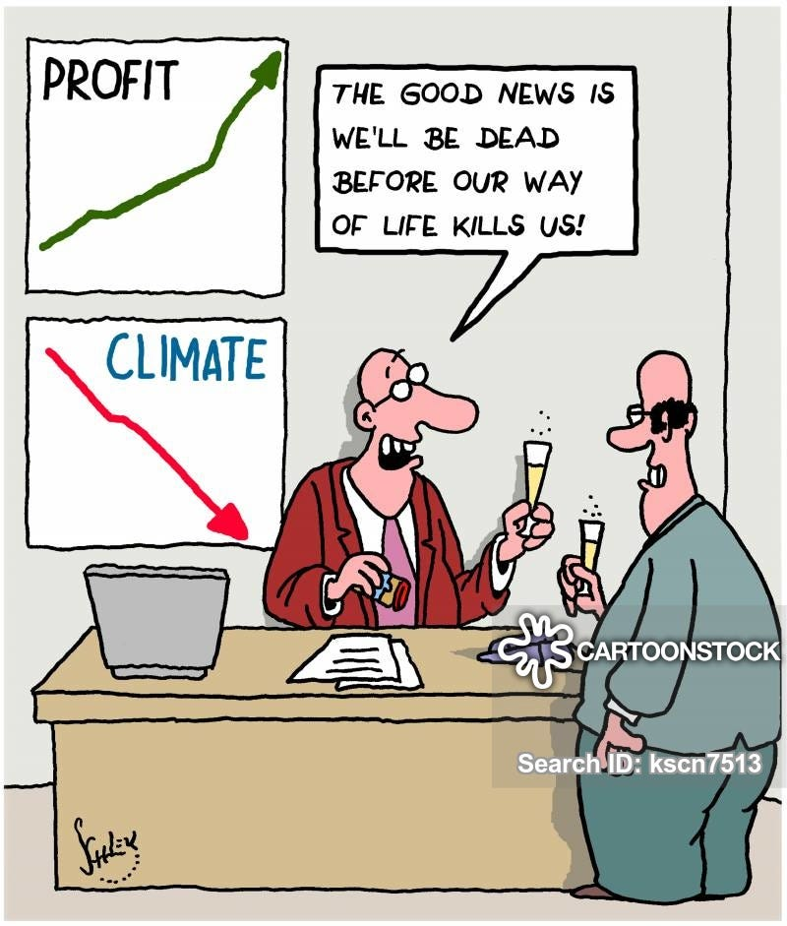
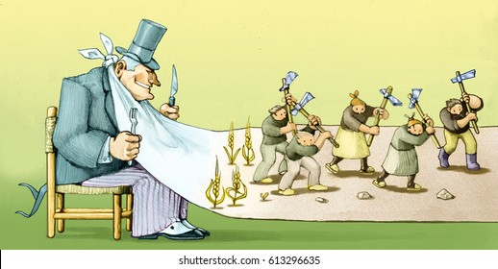
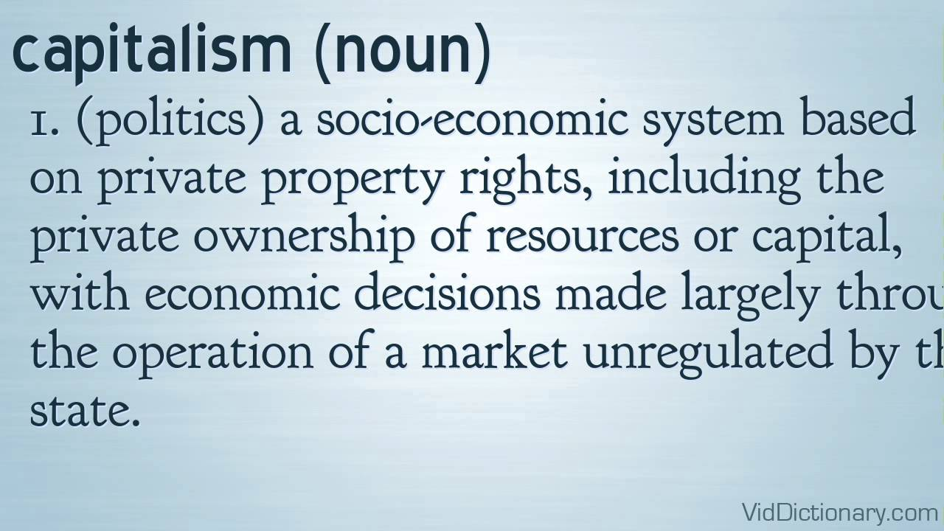

Slide 14
Socialism
Socialism advocates for collective or governmental ownership and control of the means of production, distribution, and exchange. Ethical issues in socialist systems might include:
Resource Allocation: Ethical questions arise over the fair distribution of resources, jobs, and wealth.
Government Control: The concentration of power in the hands of the government can lead to unethical practices, such as corruption and lack of individual freedom.

Slide 15
Communism
Communism is a political and economic ideology advocating for a classless society where the means of production are commonly owned. Ethical issues in communism include:
State Control: The totalitarian nature of some communist regimes can result in human rights violations.
Freedom of Choice: The lack of private enterprise may limit personal freedom and economic opportunities.

Slide 16
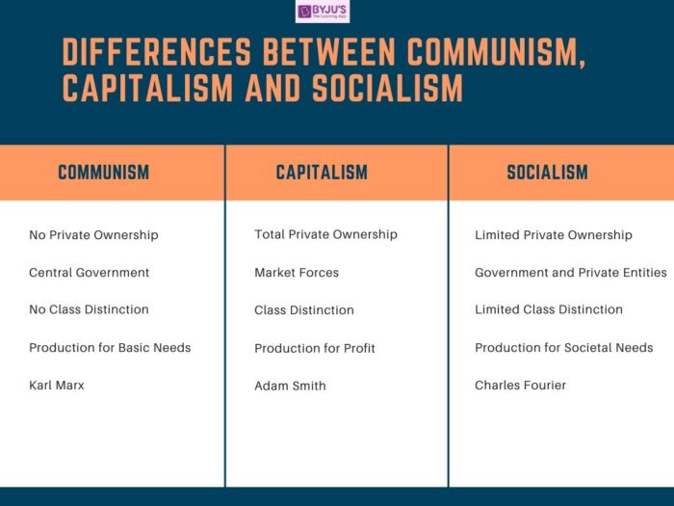

Slide 17
Business Ethics & Global Business Practices
Global businesses face ethical challenges that arise from differing cultural norms and legal standards. Ethical issues in global business practices may include:
Corruption: In some countries, bribery or other corrupt practices are normalized, leading to ethical dilemmas for businesses operating internationally.
Labor Rights: Businesses sourcing products from countries with poor labor standards may be complicit in unethical practices like child labor or unsafe working conditions.
Environmental Responsibility: International companies must balance profitability with environmental sustainability, particularly in developing countries with weak environmental laws.

Slide 18
Consumerism
Consumerism emphasizes the protection and promotion of consumer interests. Ethical concerns in consumerism include:
Exploitation: Companies may engage in practices that deceive or unfairly target vulnerable consumers.
Environmental Impact: Overconsumption driven by marketing practices can lead to resource depletion and environmental harm.

Slide 19
Human Rights, Healthcare, and Labour
Business operations that violate human rights, neglect healthcare responsibilities, or exploit labor can lead to serious ethical issues. Ethical business practices ensure workers' rights are protected and healthcare standards are upheld.
Sustainable Development
Businesses must prioritize sustainability by minimizing environmental damage and ensuring long-term economic stability. Ethical businesses engage in practices that protect the environment, use resources efficiently, and contribute to social well-being.

Slide 20
Ethical Decision-Making Models

Slide 21
Tucker’s 5 question model
Tucker’s 5 question model for ethical decision-making in business is based on the view that the profit motive is justified, and the purpose of decision-making in business should be to make a profit.
However, profits should be made in an ethical way. In order to be ethically correct, business decisions and actions should be legal. Activities outside the law by a business cannot be correct.

Slide 22
Business should also be conducted in a fair way, without deception or other ‘under-hand’ acts.
For example, competitors should be treated with respect, and customers and employees should be treated in a fair way.
Tucker’s model is also based on the view that decisions should not be taken in business if they do not support sustainable business or could be damaging to the environment.

Slide 23
Five questions
Is it profitable?
Is it legal?
Is it fair?
Is it right?
Is it sustainable or environmentally sound?

Slide 24
Scenario
An international company is planning to build a new manufacturing plant in a developing country. The country was chosen because costs of land and labour are cheap, so the forecast profits are high. The plant will be built on a ‘brown field’ site just outside the country’s capital city, which used to be the site of another factory that has now been closed down. The company intends to build a plant that will use modern technology that keeps environmental emissions at a low level. The country’s government has approved the building of the new plant, and the local population is eagerly waiting for construction to begin, bringing with it much needed commercial activity – and jobs. The government believes that the plant will bring economic growth to the country’s economy.

Slide 25
Answer
Question 1. Is it profitable? The answer seems to be Yes. The country was chosen because of its low cost of land and labour.
Question 2. Is it legal? The answer seems to be Yes, because the government has given permission for the plant to be built.
Question 3. Is it fair? There is no reason to suppose that it is not fair. The only stakeholders in the example are the government and the local population. Both seem to support the building of the plant, and this suggests that the project is fair.
Question 4. Is it right? The answer seems to be Yes. The project will bring jobs, wealth and economic growth. There are no obvious reasons why the project is ‘Not right’.
Question 5. Is it sustainable or economically sound? The answer seems to be Yes, because the plant will be built using modern technology that keeps environmental emissions at a low level. In this simple case, the decision to build the plant would be ethical.

Slide 26
American Accounting Association (AAA) model
The seven question in the model are:
(1)What are the facts of the case?
(2)What are the ethical issues in the case?
(3)What are the norms, principles and values related to the case?
(4)What are the alternative courses of action?
(5)What is the best course of action that is consistent with the norms, principles and values identified in step 3?
(6)What are the consequences of each possible course of action?
(7)What is the decision?

Slide 27
Two Stages of ethical decision making
Ethical decision making involves:
a 4-stage process
is influenced by individual and situational factors
can be applied to Kohlberg's CMD theory (chapter 13) in terms of business decision making.
The four stages of ethical decision making can be summarised as follows:

Slide 28
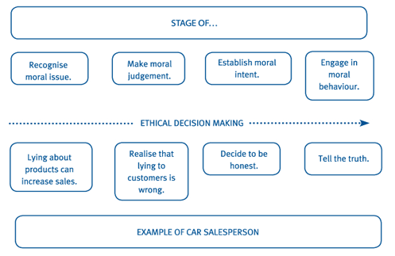

Slide 29
The model distinguishes between
knowing what is the correct thing to do (recognising the moral issue) and
the actual action taken (the moral behaviour â€“ or lack of it).
So the salesperson could still lie about the cars being sold even though this had been recognised as immoral behaviour.
Factors influencing the moral decision:
The actual moral decision taken will depend on:
Individual factors: unique characteristics of the individual making the decision such as age, gender, and experience acquired during life.
Situational factors: particular factors in the decision area that cause an individual to make an ethical or unethical decision.

Slide 30
Ethical decision making
The individual and situational factors in the ethical decision-making process fit well with the Kohlberg theory described in an earlier chapter.
A summary of the theory is repeated here for convenience.
The actual moral decision taken will depend on:
Individual factors: unique characteristics of the individual making the decision such as age, gender, and experience acquired during life.
Situational factors: particular factors in the decision area that cause an individual to make an ethical or unethical decision.

Slide 31
The 'Example in business' column shows that:
Individual factors become more important in the higher-level decisions. The decision maker is making ethical decisions because they themselves believe that is the correct course of action.
Situational factors appear to be more important at lower-level decisions. In these areas, the decision maker appears to make decisions based on what is expected of them in that situation, rather than on their own values and beliefs.

Slide 32
Case
A drinks manufacturer has discovered that some fizzy drinks accidentally contain harmful additives as a result of an error in production.
With reference to the ethical decision making model, provide examples of each stage as the company decides on whether to inform customers of this issue.

Slide 33
Solution
Recognise moral issue: Not providing the information may have an adverse effect on the company's sales.
Make moral judgement: Realise that lying by default (not providing the information) is wrong and that customers could be harmed by consuming the drink.
Establish moral intent: Decide to make the information on the production error known.
Engage in moral behaviour: Inform customers of the production error and recall the drinks.

Slide 34
Reference
https://kfknowledgebank.kaplan.co.uk/acca/chapter-14-ethical-decision-making

Slide 35
Truckers 5 question model
In the year 20X5, BioTechX, a leading biotechnology company, developed a new type of synthetic biodegradable plastic that they claimed would revolutionize the plastic industry. The new plastic was designed to break down faster than traditional plastics, reducing the long-term environmental impact. The company marketed the product as eco-friendly, with significant media attention and consumer demand. BioTechX rapidly expanded its production capacity and began selling the plastic globally, securing large contracts with major retailers, food packaging companies, and the construction industry.
However, a few years into mass production, independent researchers discovered that while the plastic did break down faster than traditional plastics, it released harmful microtoxins into the environment during its decomposition process. These microtoxins began to contaminate soil and water sources, posing serious risks to both wildlife and human health. Despite these findings, BioTechX continued to push forward with its production, arguing that the immediate environmental benefits outweighed the long-term risks. The company also downplayed the findings, failing to inform consumers or regulators about the potential dangers of the new material.

Slide 36
In this futuristic case study, BioTechX’s decision to continue producing a synthetic biodegradable plastic despite the risks of harmful microtoxins represents a clear example of unethical decision-making. Using Trucker’s 5-question model, we can see that the decision is:
Legally questionable, as it may not yet violate existing laws but disregards potential risks.
Unbalanced, as the company fails to consider the full environmental and health impacts of their product in favor of immediate profits.
Emotionally troubling, as it would generate feelings of betrayal and anger in consumers, environmentalists, and affected communities.
Morally harmful if you are directly impacted by the environmental contamination and health risks.
Globally dangerous, as widespread adoption of such decisions could exacerbate environmental degradation and public health risks.
In this scenario, BioTechX's decision highlights the need for a more responsible approach to innovation and product development that considers long-term sustainability, transparency, and the real-world impact on people and the environment.

Slide 37
AAA
Background: In 2045, GreenFuel, a company that produces biofuels from algae, has become a leader in the renewable energy industry. They claim their biofuels are a clean, sustainable alternative to traditional fossil fuels. However, GreenFuel has started cutting costs by using genetically modified algae strains that produce biofuels quickly but have adverse environmental effects, such as disrupting local ecosystems and contaminating nearby freshwater sources. The company is aware of these environmental issues but has not taken action to address them, instead opting to ignore or downplay them to maintain profits and public image.

Slide 38
GreenFuel’s decision to continue producing biofuels using harmful genetically modified algae strains, despite being aware of the environmental harm it causes, is unethical. Using the AAA Model and its 7 ethical questions, we can see that:
The decision is inconsistent with the facts about the environmental harm.
It does not comply with the spirit of the law, even if it follows legal guidelines.
It does not treat all stakeholders fairly, especially those affected by the environmental damage.
It is not ethically justifiable because the negative consequences outweigh the positive environmental benefits.
The long-term consequences are harmful to both the environment and the company.
It could not be justified to a reasonable person, given the known risks.
It is inconsistent with the values of the company, which claims to prioritize sustainability.
This case demonstrates how companies may adopt practices that seem environmentally friendly on the surface, but unethical production methods undermine their claims and cause long-term damage. Ethical decision-making must consider all stakeholders, long-term consequences, and align with the company’s values and societal expectations.

